Slide 1
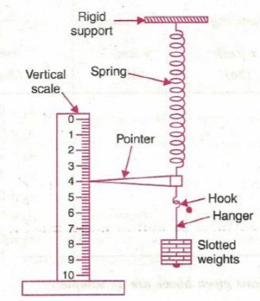
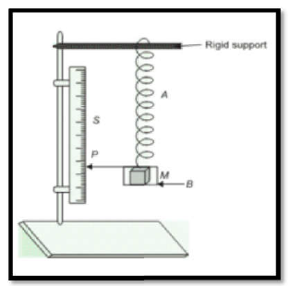
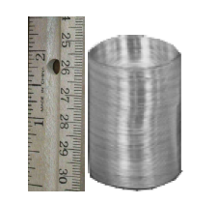
( A/Prof Syed Hussain Shah) To Measure the Spring constant “k” by static and dynamic methods and to find the mass of the spring.

Slide 2
Mass Spring System Is Rubber more elastic than steel? The answer lies in the concept of elasticity.
Apparatus: Spiral spring, Pointer, Slotted Weights, Stop Watch, Meter rod
Introduction:
A spring is an elastic material which stores mechanical energy. Springs are usually made of hardened steel. The spring constant k of an ideal spring is defined as the force per unit length of the spring and is different from one spring to another. Spring constant is represented in Newton/ Meter (N/M).

Slide 3
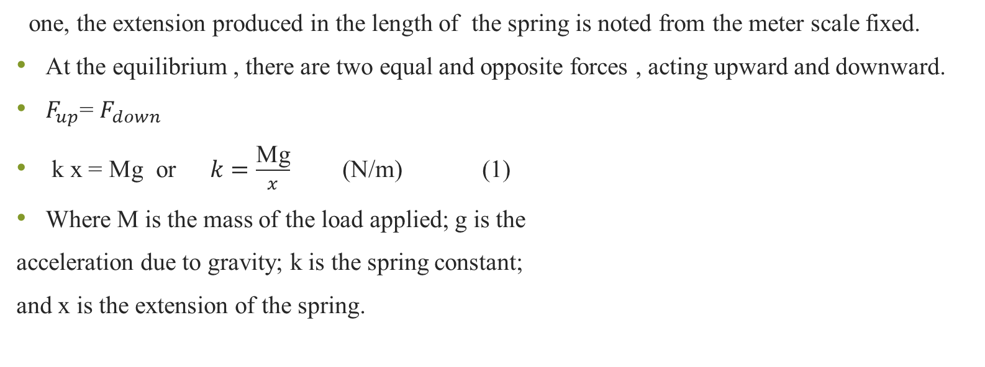
Modes of Determination: 1) Static Mode: In this mode a weight is added to the spring and its extension is measured. The spring is fixed at one end and a weight is added in equal amounts one by
one, the extension produced in the length of the spring is noted from the meter scale fixed.
At the equilibrium , there are two equal and opposite forces , acting upward and downward.
$F_{up}$= $F_{down}$
k x = Mg or $k=\frac{\text{Mg}}{x}$ (N/m) (1)
Where M is the mass of the load applied; g is the
acceleration due to gravity; k is the spring constant;
and x is the extension of the spring.

Slide 4
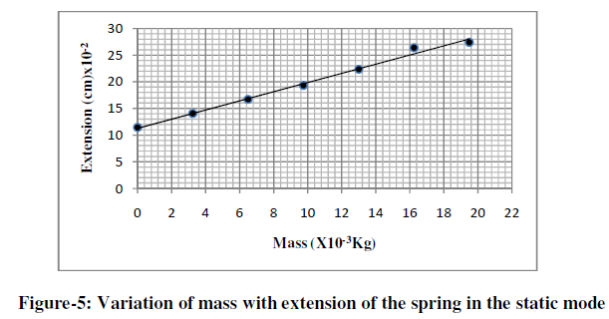
Plotting M vs x, a straight line is drawn. The value of k is measured from the inverse slope of the line.

Slide 5

2. Dynamic Mode: If the same spring is made to oscillate by pulling the weight applied to it downward, it executes a simple harmonic motion.
F= Ma
F= -kx or
Ma + kx =0 as $a=$ $d^{2}$x /${dt}^{2}$
M $\frac{d^{2}\text{x}}{{dt}^{2}}$ + k x =0 or $\frac{d^{2}\text{x}}{{dt}^{2}}+ \frac{k}{M}$x= 0 (2)
Solving equation 2 for time period of the
spring we get
T= 2π $\sqrt{\frac{M}{k}}$ (3)

Slide 6
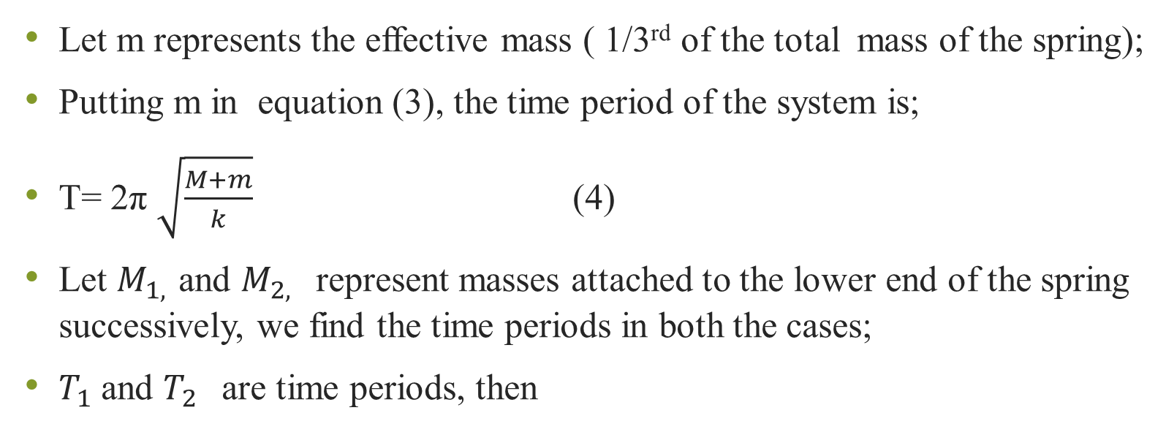
Let m represents the effective mass ( 1/3rd of the total mass of the spring);
Putting m in equation (3), the time period of the system is;
T= 2π $\sqrt{\frac{M+m}{k}}$ (4)
Let $M_{1, }$and $M_{2, }$represent masses attached to the lower end of the spring successively, we find the time periods in both the cases;
$T_{1}$ and $T_{2 }$are time periods, then

Slide 7
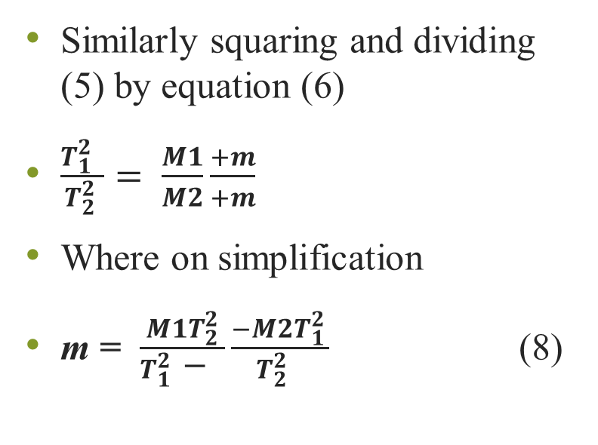
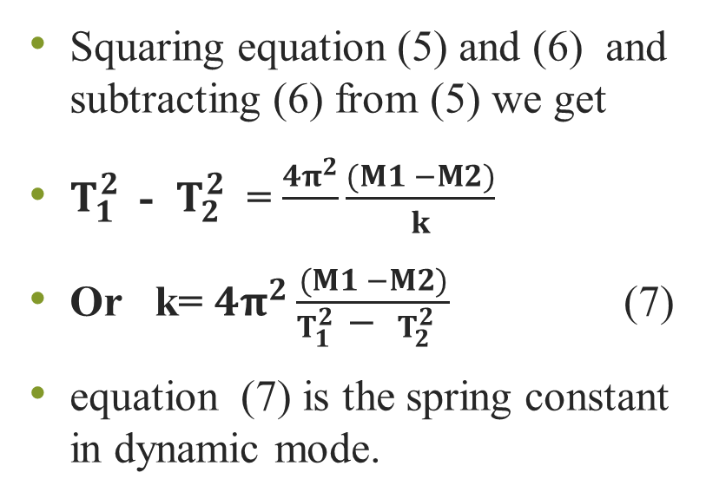
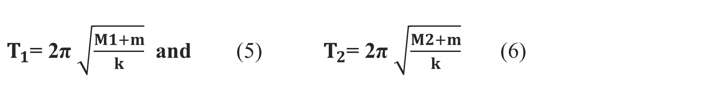
$T_{1}$= 2π $\sqrt{\frac{M1+m}{k}}$ and (5) $T_{2}$= 2π $\sqrt{\frac{M2+m}{k}}$ (6)
Squaring equation (5) and (6) and subtracting (6) from (5) we get
${T_{1}^{2} }_{ }$- ${T_{2 }^{2} }_{ }$= $\frac{{4π}^{2}}{}\frac{(M1 −M2)}{k}$
Or k= ${4π}^{2}\frac{(M1 −M2)}{{T_{1}^{2} }_{ }\text{− }{T_{2 }^{2} }_{ }}$ (7)
equation (7) is the spring constant in dynamic mode.
Similarly squaring and dividing (5) by equation (6)
$\frac{{T_{1}^{2} }_{ }}{T_{2 }^{2}}= \frac{M1}{M2}\frac{+m}{+m}$
Where on simplification
m = $\frac{M1T_{2}^{2}}{{T_{1}^{2} }_{ }\text{− }}\frac{−M2T_{1 }^{2}}{{T_{2 }^{2} }_{ }}$ (8)

Slide 8
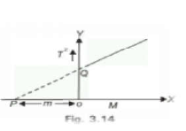

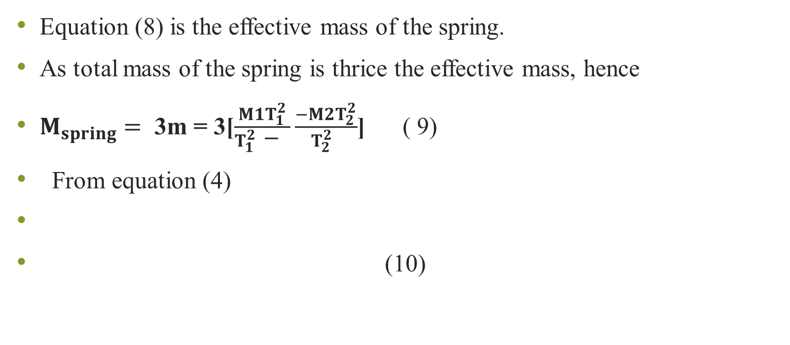
Equation (8) is the effective mass of the spring.
As total mass of the spring is thrice the effective mass, hence
$M_{spring}=$ 3m = 3[$\frac{M1T_{1}^{2}}{{T_{1}^{2} }_{ }\text{− }}\frac{−M2T_{2 }^{2}}{{T_{2 }^{2} }_{ }}$] ( 9)
From equation (4)
(10)

Slide 9
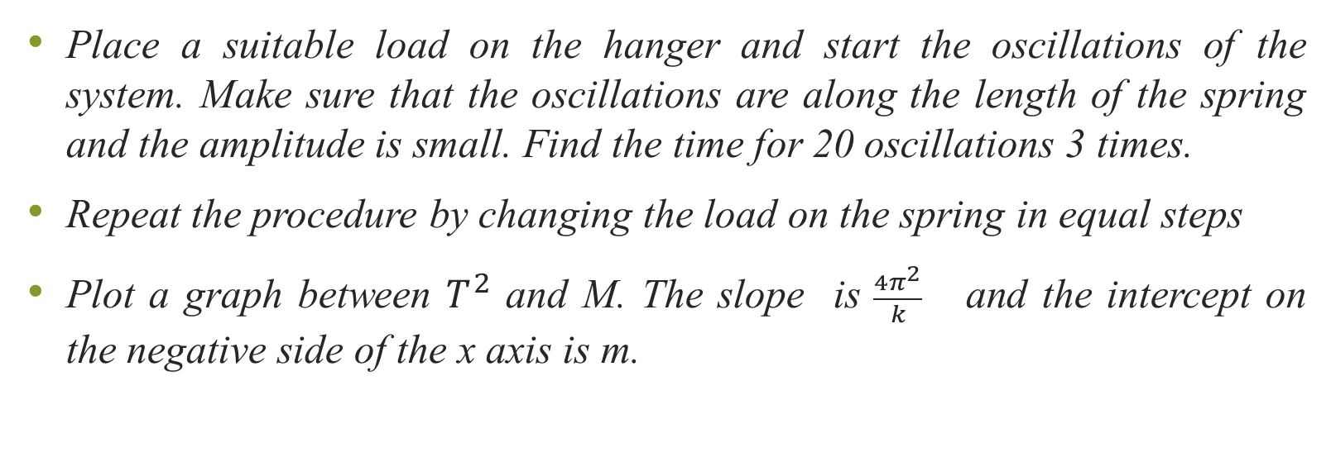
Procedure for Dynamic Method
Place a suitable load on the hanger and start the oscillations of the system. Make sure that the oscillations are along the length of the spring and the amplitude is small. Find the time for 20 oscillations 3 times.
Repeat the procedure by changing the load on the spring in equal steps
Plot a graph between $T^{2 }$and M. The slope is $\frac{{4π}^{2}}{k}$ and the intercept on the negative side of the x axis is m.

Slide 10
